Slide 1
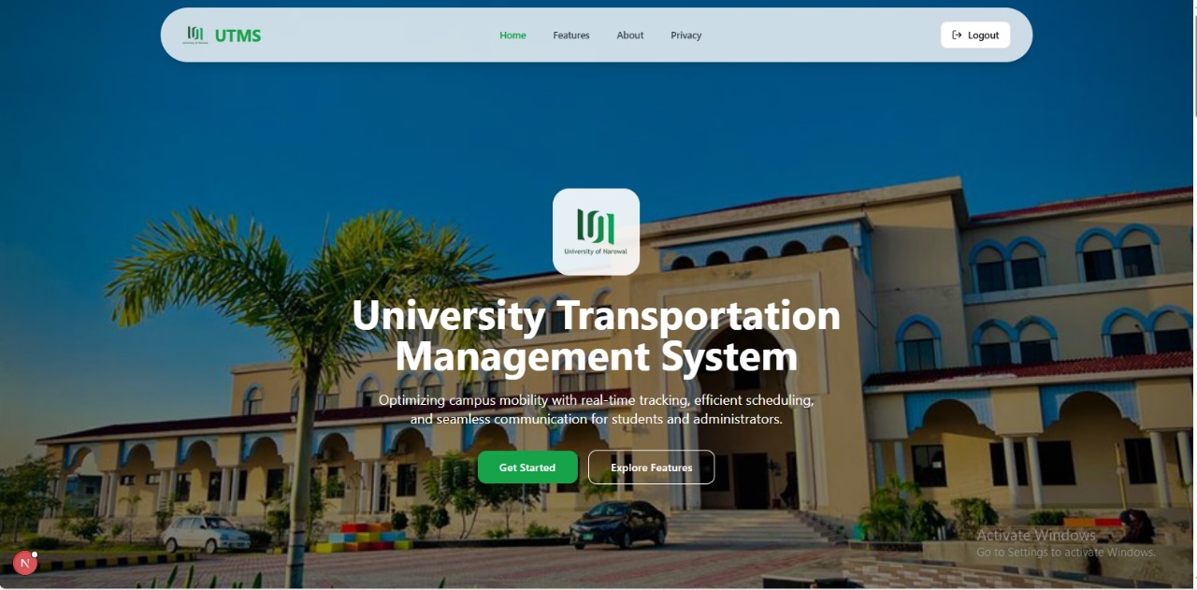
UTMS-A University Transport Management System
Supervised by:
Mr. Zaeem Nazir

Slide 2
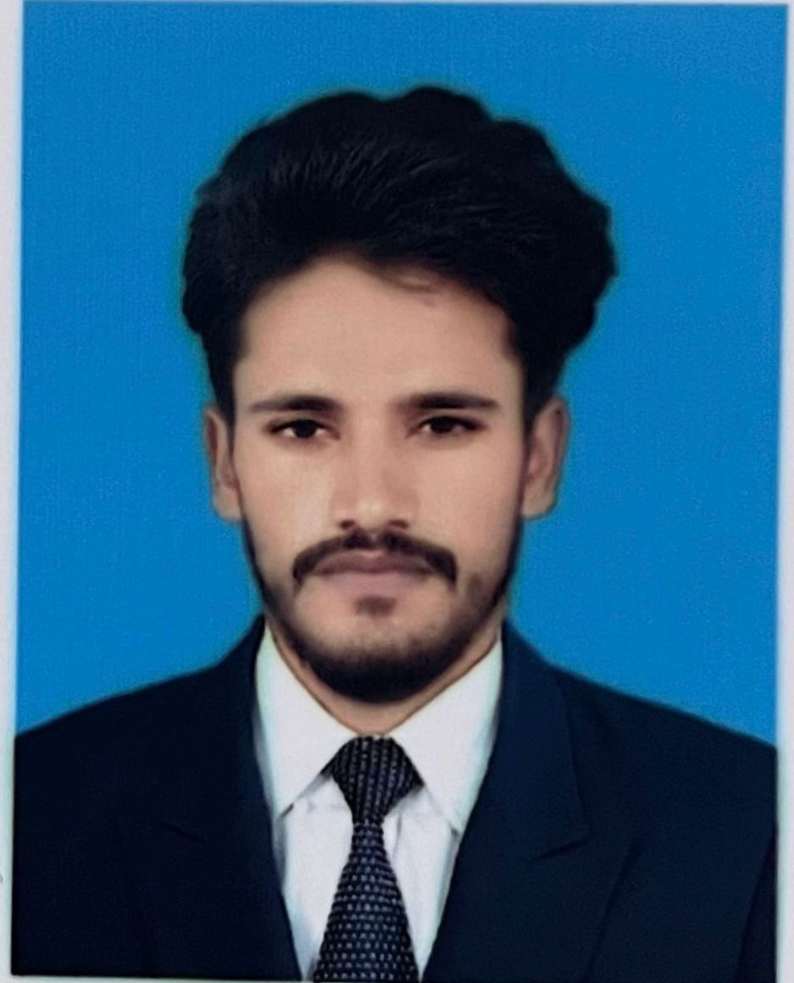
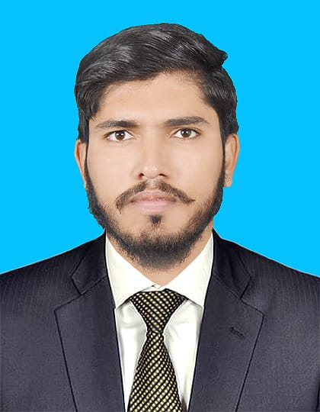

Brief Introduction of Team
Ahmad Sultan
(21-UON-0906)
Full Stack Web developer
M. Adeel
(21-UON-0923)
Front End designer
Zeenat Arooj
(21-UON-0948)
Documentation and Project Management

Slide 3
Table of contents
01
Project title and problem statement
02
Objectives and scope
03
Methodology
04
Tools and Technologies
06
05
Implementation progress
System arch. And Design

Slide 4
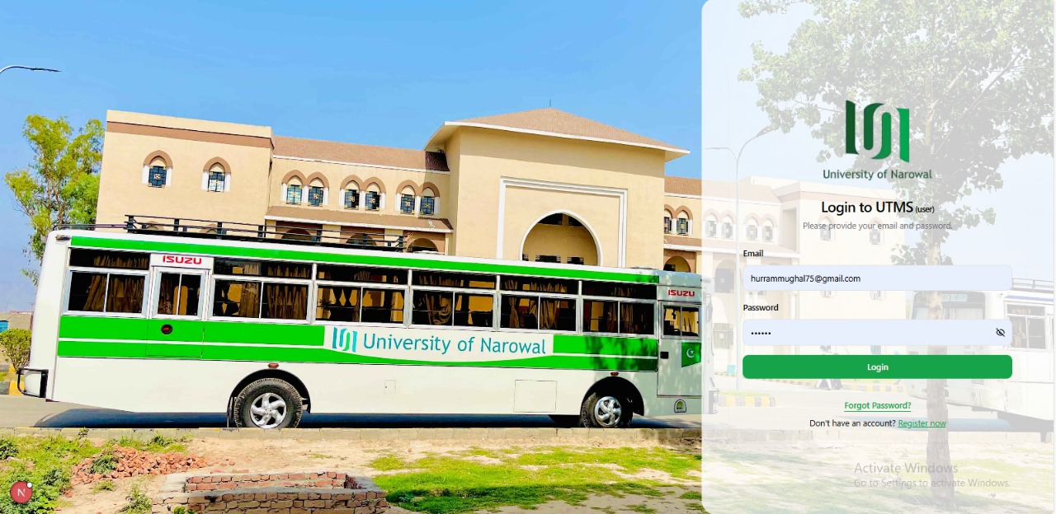
Title: UTMS
University Transport Management System
Problem Statement:
Manual transport management in universities leads to inefficiencies, poor record-keeping, and lack of communication between students and the admin. There is a need for a centralized digital system to streamline challan generation, route management, and overall transport operations.

Slide 5
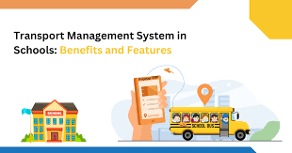
Objectives
02
Student Self-Service: Enable students to register, select routes, and generate transport challans through an online portal.
01
Digitize Transport Operations: Develop a centralized web-based system for managing university transport efficiently.
04
Improve Transparency: Ensure clear status tracking of challans (paid/unpaid) and student-route assignments.
03
Admin Dashboard: Provide admin with tools to approve challans and manage buses, drivers, and routes.
Digital Transport System

Slide 6
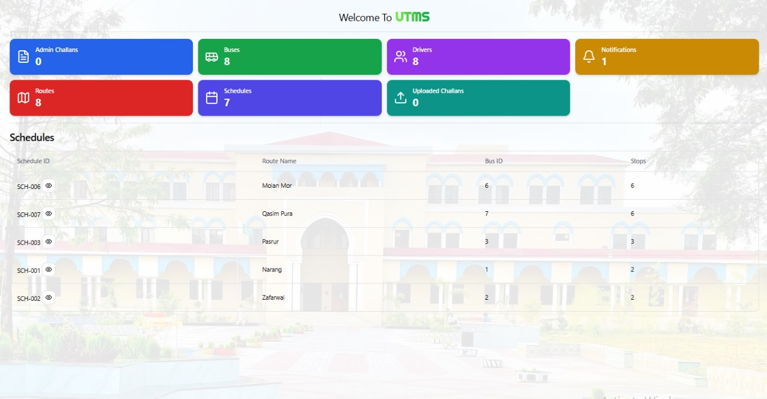
Scope
01
Web-based system with separate portals for students and admins.
02
Students can register, select routes, and generate challans..
03
Admins can approve challans and manage buses, routes, and drivers
04
Notify students with updates and approval from admin.

Slide 7
Methodology
Stepwise incremental approach of developing UTMS
01 Discover: Talked to students and admins to understand transport issues and gather key requirements.
02 Design & Plan: Sketched user flows and system architecture with a focus on simplicity and usability
03 Build: Frontend: React.js + HTML/CSS Backend: Node.js + Express.js Database: MongoDB
04 Test & Fix: Tested all features manually — from challan generation to route management — and squashed bugs!
05 Deploy & Demo: Ran the system locally for testing and presentation. Ready to scale and deploy in the future!

Slide 8
Tools and Technologies
🔹 Frontend: React.js, HTML, CSS
🔹 Backend: Node.js, Express.js
🔹 Database: MongoDB
🔹 Languages: JavaScript, HTML, CSS
🔹 Tools: VS Code, GitHub
🔹 Platform: Web-based (Localhost)

Slide 9
System Architecture – Campus Wheel
Student Portal
User registration
Route selection
Challan generation
Admin Portal
Approve challans
Manage buses/routes/drivers
Backend Server
(Node.js + Express.js)
Database
(MongoDB)

Slide 10
System Design – UTMS
Student Interface
Simple registration & login
Route and challan selection
Easy-to-use dashboard
Admin Interface
Login with authentication
Manage routes, buses, drivers
Approve challans
API Integration
REST APIs built using Node.js
Smooth communication with MongoDB
Authentication
Role-based access (Student/Admin)
Secure login system
Responsive Design
Desktop friendly UI
Developed using HTML, CSS & React.js

Slide 11
Implementation Progress
December: Project planning, requirement gathering
January: Frontend UI development (React.js)
February: Backend setup with Node.js & Express
March: Database integration with MongoDB
April: User and Admin functionalities implemented
May: Testing, bug fixing, final documentation

Slide 12
Visual Representation
1. Home Layout

Slide 13
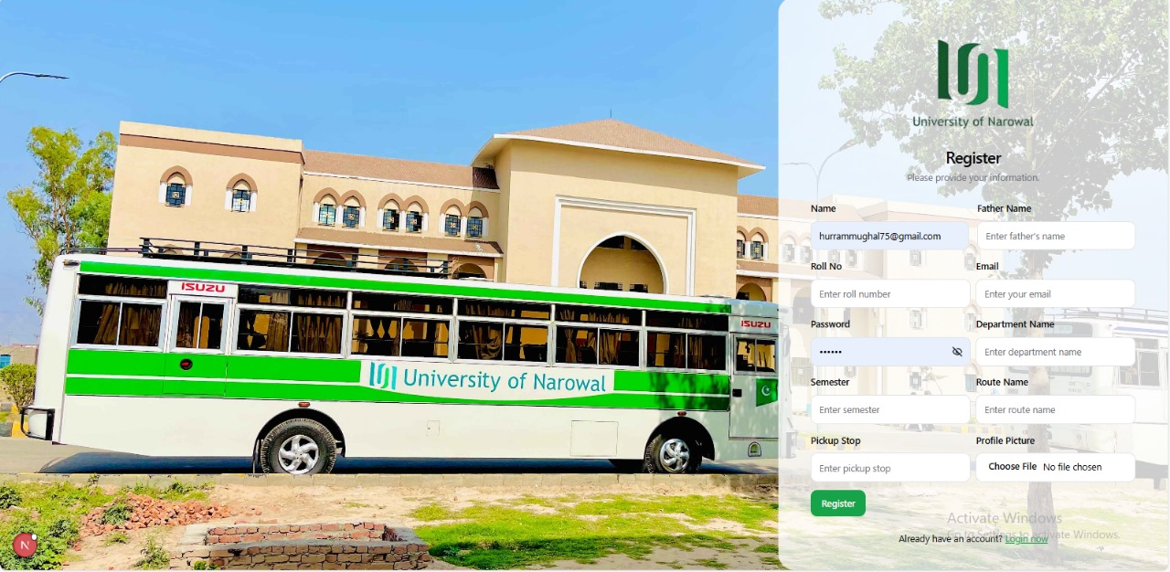
Visual Representation
2. Student Registration and Login

Slide 14
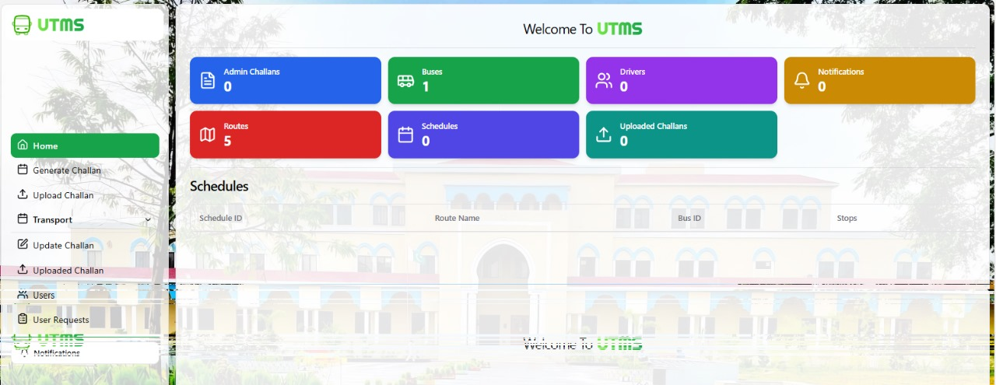
Visual Representation
3. Admin Page

Slide 15
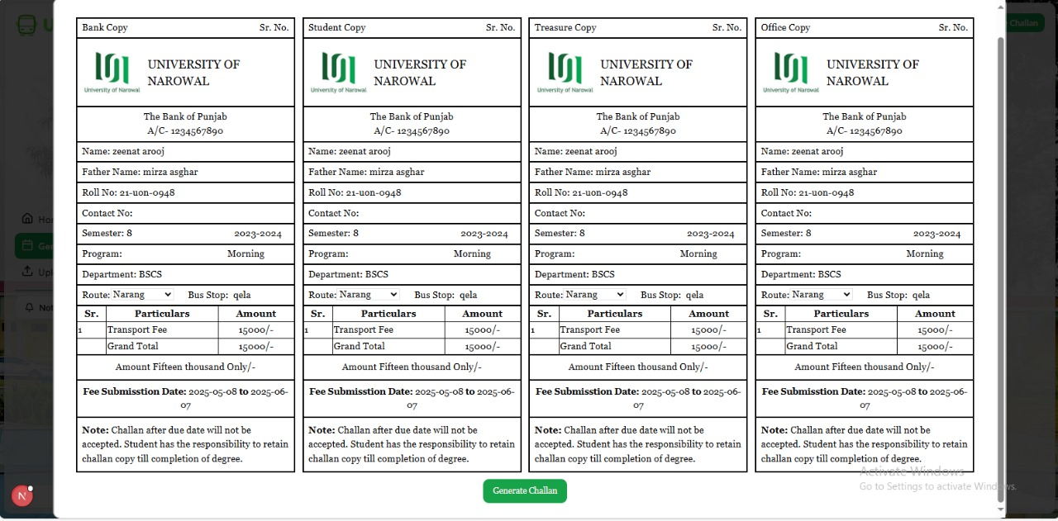
Visual Representation
4. Generated challan

Slide 16

Thanks!

